Slide 1

Data Strategy
V0.1

Slide 2
Current System Context Diagram
External Apps
SORs
Data Platforms/ Reporting tools/ Apps
Tibco
Salesforce
FileNet
SEI
WebKYC
Advantage
ODS
DAS-H
FileNet
BAW Platform
Hosted APPS
Workflow Center
Workflow Server
CTAO
PTAO
CCBLW
ITAO
SPQR
Up to 17 apps
Portal
Future: App databases can be moved to more flexible object-oriented database
DB Server: SQL Server
Product/Platform (BAW) Database
Applications Databases
Process DB
Performance DB
CTAO
PTAO
CCBLW
ITAO
SPQR
Up to 17 databases
Read
Update
Rest Read
Rest Update

Slide 3
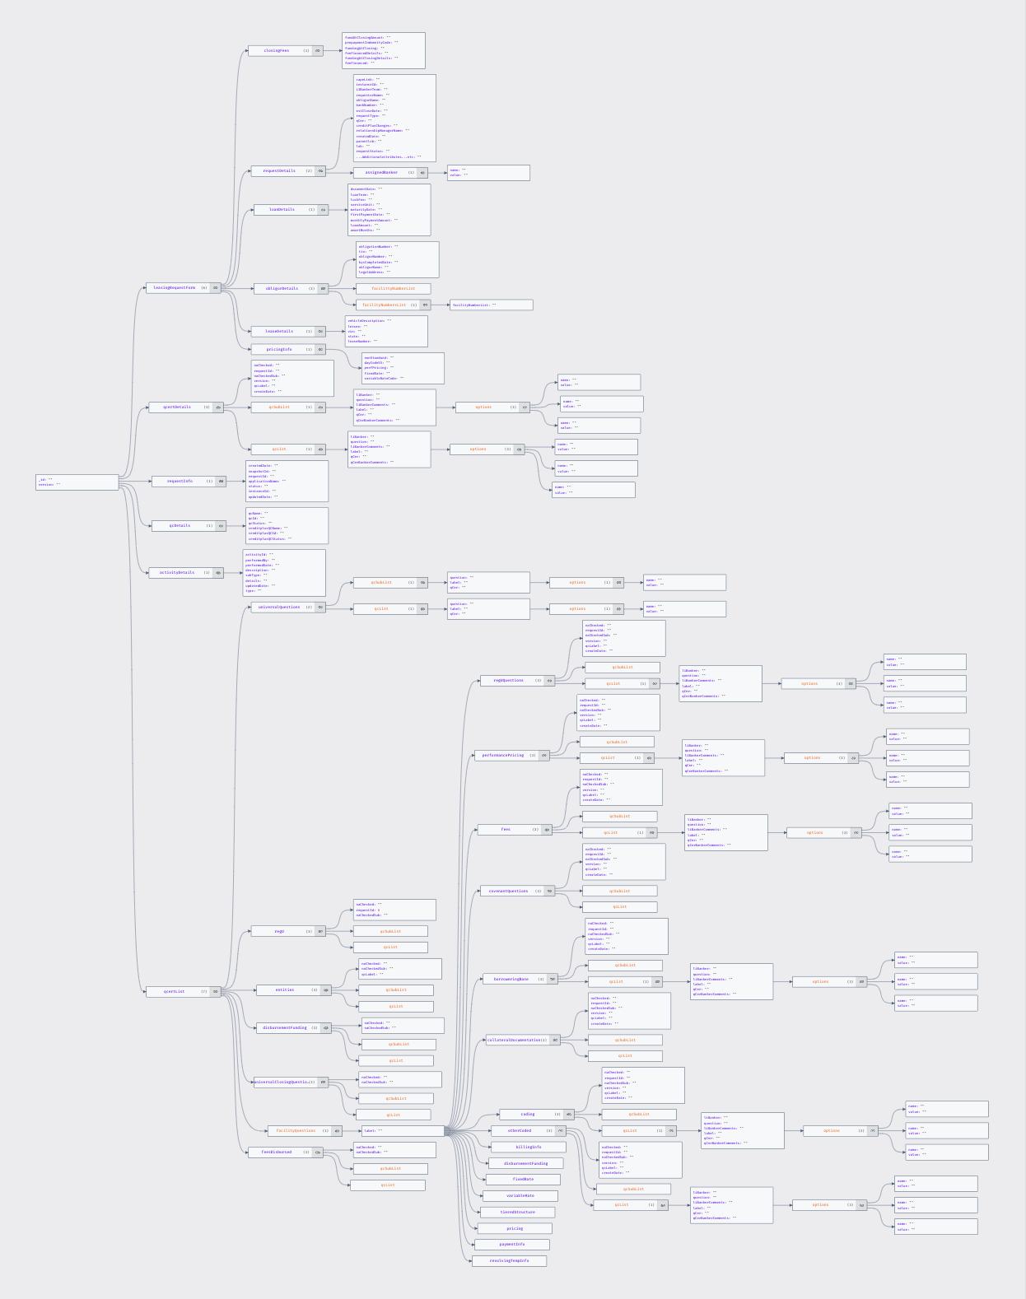
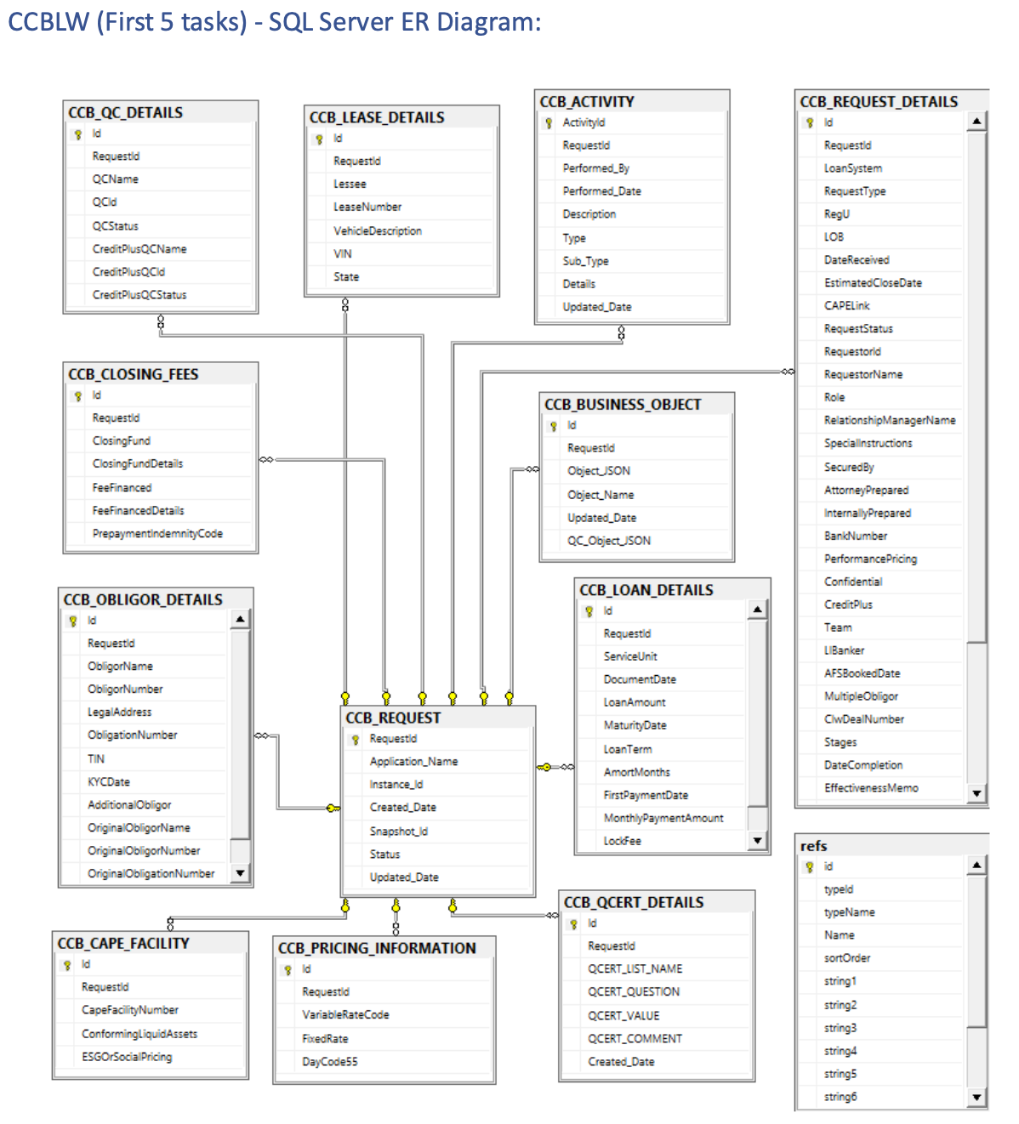
Current DB Design - Problems
Frameworks available to convert tables to Data Objects e.g., Hibernate, but:
1- Auto generate feature will not be able to generate complex hierarchy for the objects, a lot of manual intervention is needed
2. And this process is not optimal to handle changes
Extra Development cost:
Extra design Effort
Extra Development Effort
Slow access to market (Changes are not that easy to make)
Analysis Based on POC performed with CCBLW application (First 5 tasks)

Slide 4
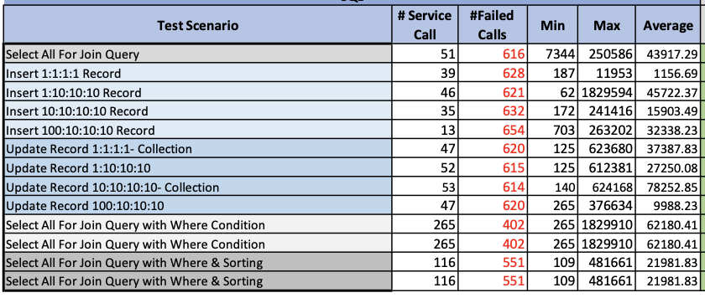
Current DB Design - Problems
We can run simple queries/ single table queries & build logic of e.g., populating objects, object lists at the application level, but it is not an optimal approach versus a database which is well versed with objects where we can use its powerful query engine to perform object operations. Generally, Query execution is more optimized at data layer versus if we do same at application layer
Impact on performance:
Slow response due to joins/complex queries
Timeout, lockout issues:
Load Test Performed with 500 concurrent users in IT Stack2 as part of POC. Time in milliseconds

Slide 5
Idea
Our Hunch is:
“We need an object-oriented data store where objects can be mapped directly to db model to be able to save/retrieve objects As-Is and we don’t need to perform additional db modeling. That data store or object store should always return consistent data. The data store should be flexible where changes in the objects can be accommodated on the fly. NoSQL DB may be a good fit here”

Slide 6
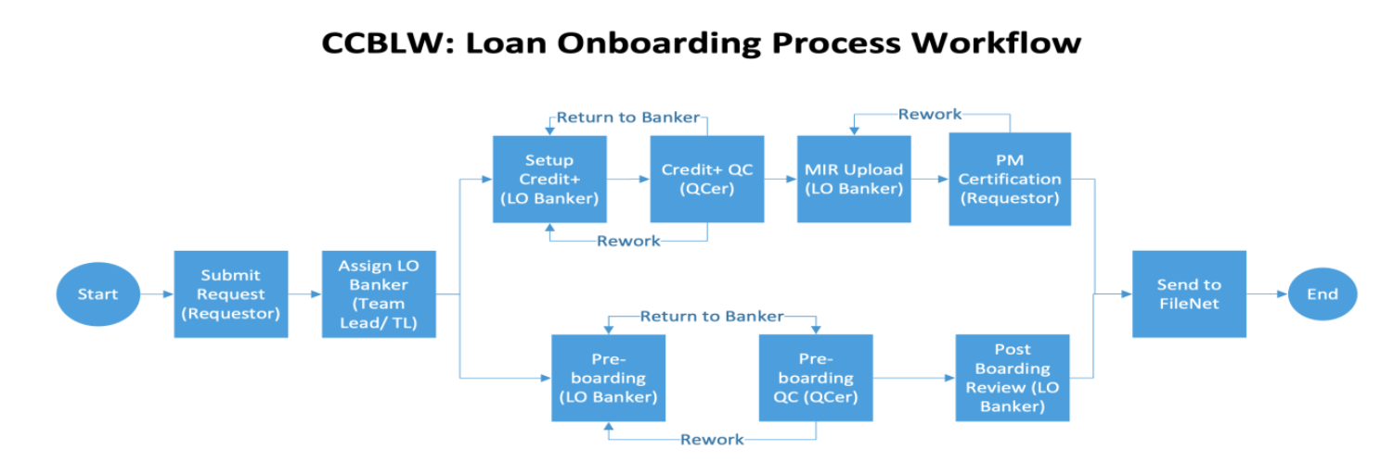
Business Case:
RDBMS is not great for the business case described here, but instead are good for SOR applications where data needs to be normalized into entities/tables and CRUD operations are performed on entities. Like If an organization has 70,000 employees, each employee has buildings’ access defined, this should be Saved in RDBS as Organization, Employee & Building tables. Otherwise. if building object is child of employee object & if there is change in building name then update will be required in thousands of places versus one place.
Object-oriented applications/workflows to handle Business Case entirely (Business Transaction Workflow), like Account or Loan Onboarding applications.
Some aspects of business Transactions are:
Data is captured from GUIs and is maintained in business objects within the scope of process instance.
Objects need to be saved As-Is or retrieved As-Is to prevent extra development effort for transformations for persistence.
Group of CRUD operations are performed as database transactions within the scope of Business Transaction.
There can be reports that can look outside Business Transactions, but CRUD operations for persistence specifically update, insert, delete are not performed by reports and it is just Reading data across Business transactions.
Any SOR data captured by Transactional application should be saved to appropriate SORs and it should not become SOR itself.
Data should be moved from Transaction application to Data Platform where data is transformed into a form to better suit Reports.
A Business transaction requires data consistency by nature.
Changes in handling of Business Transaction require changes in business Objects’ models so persistence layer should be flexible enough to accommodate their changes.

Slide 7
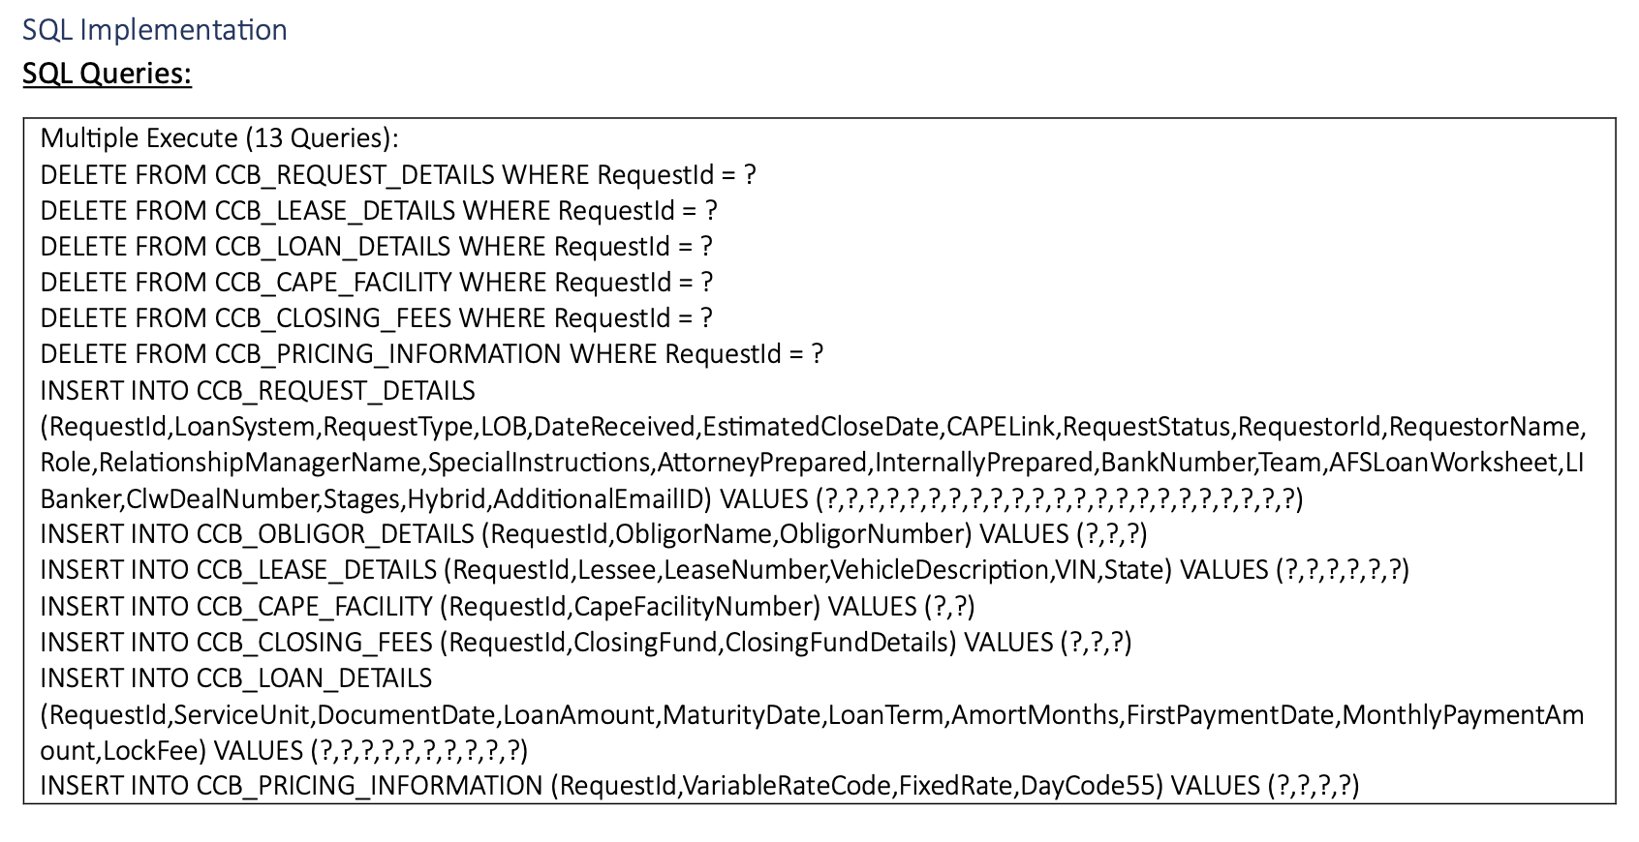
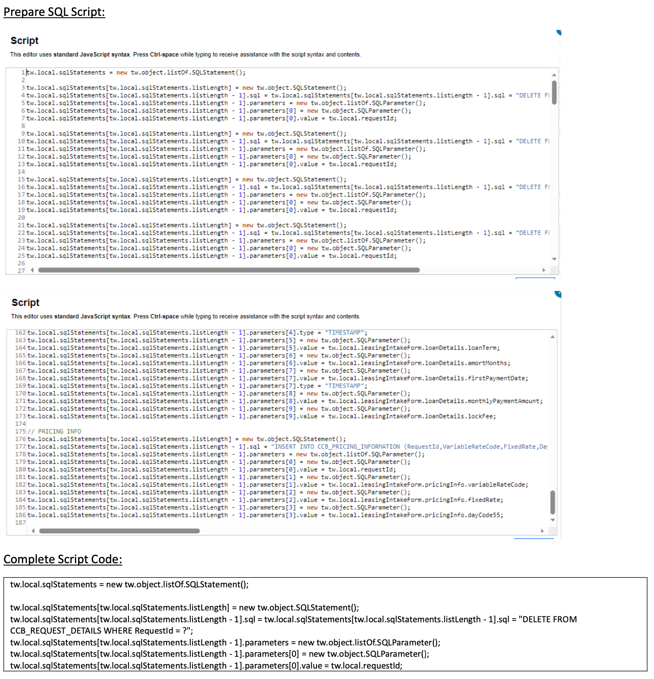
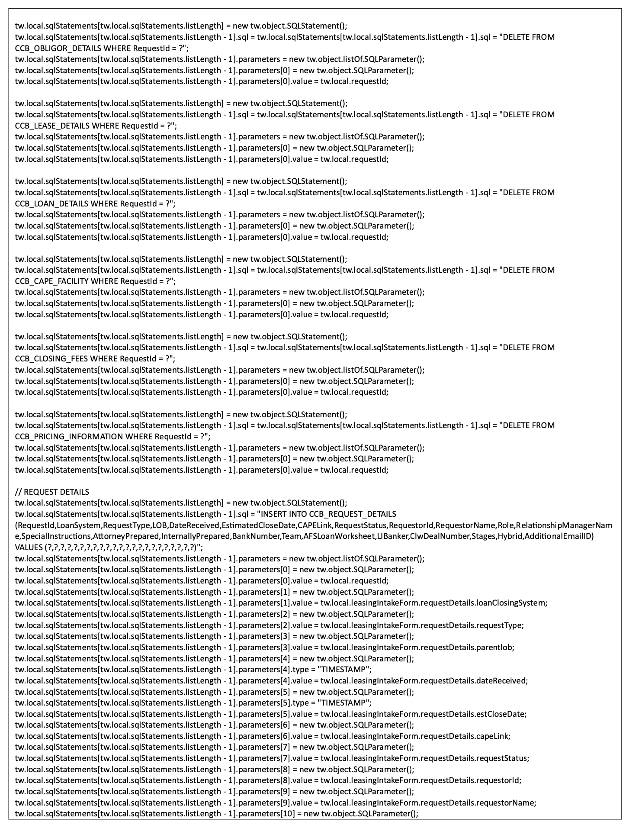
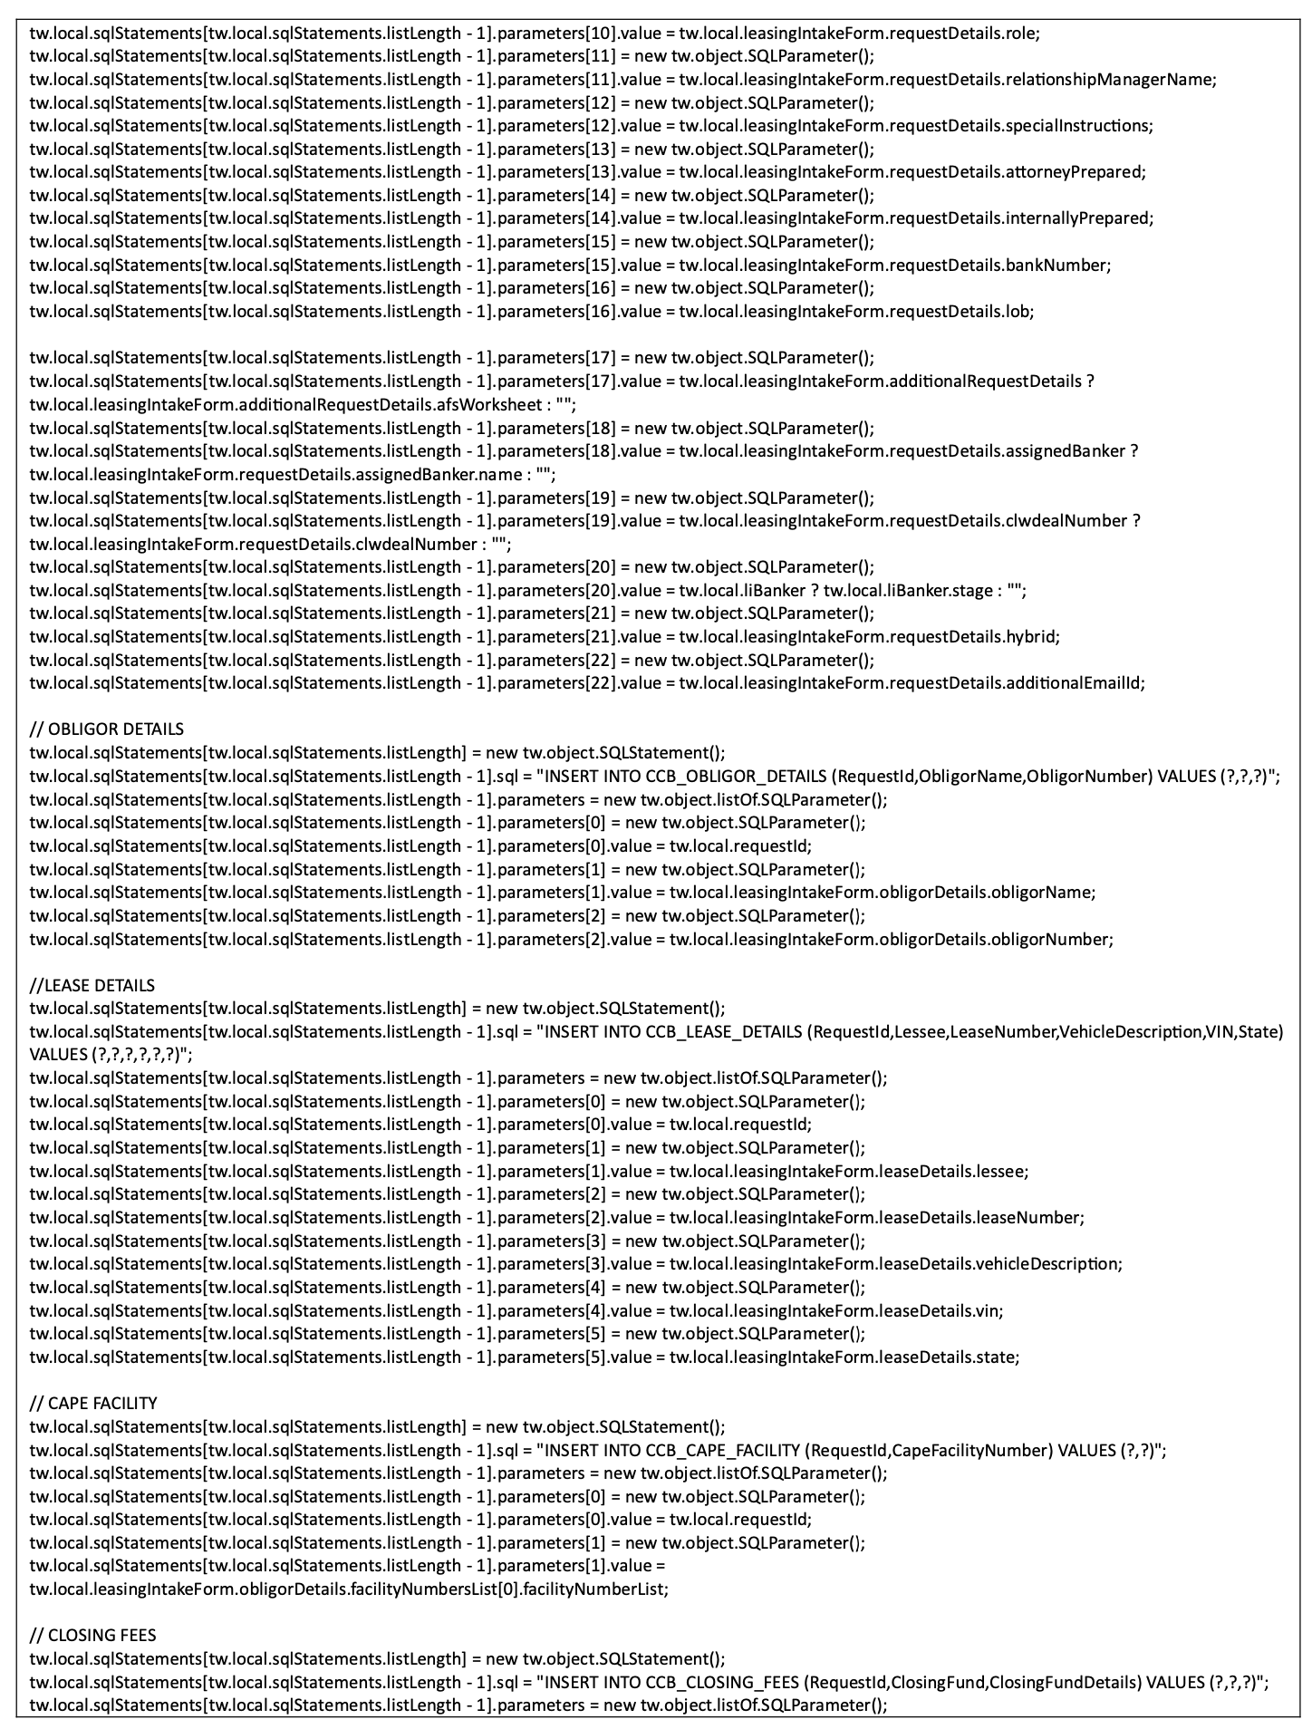
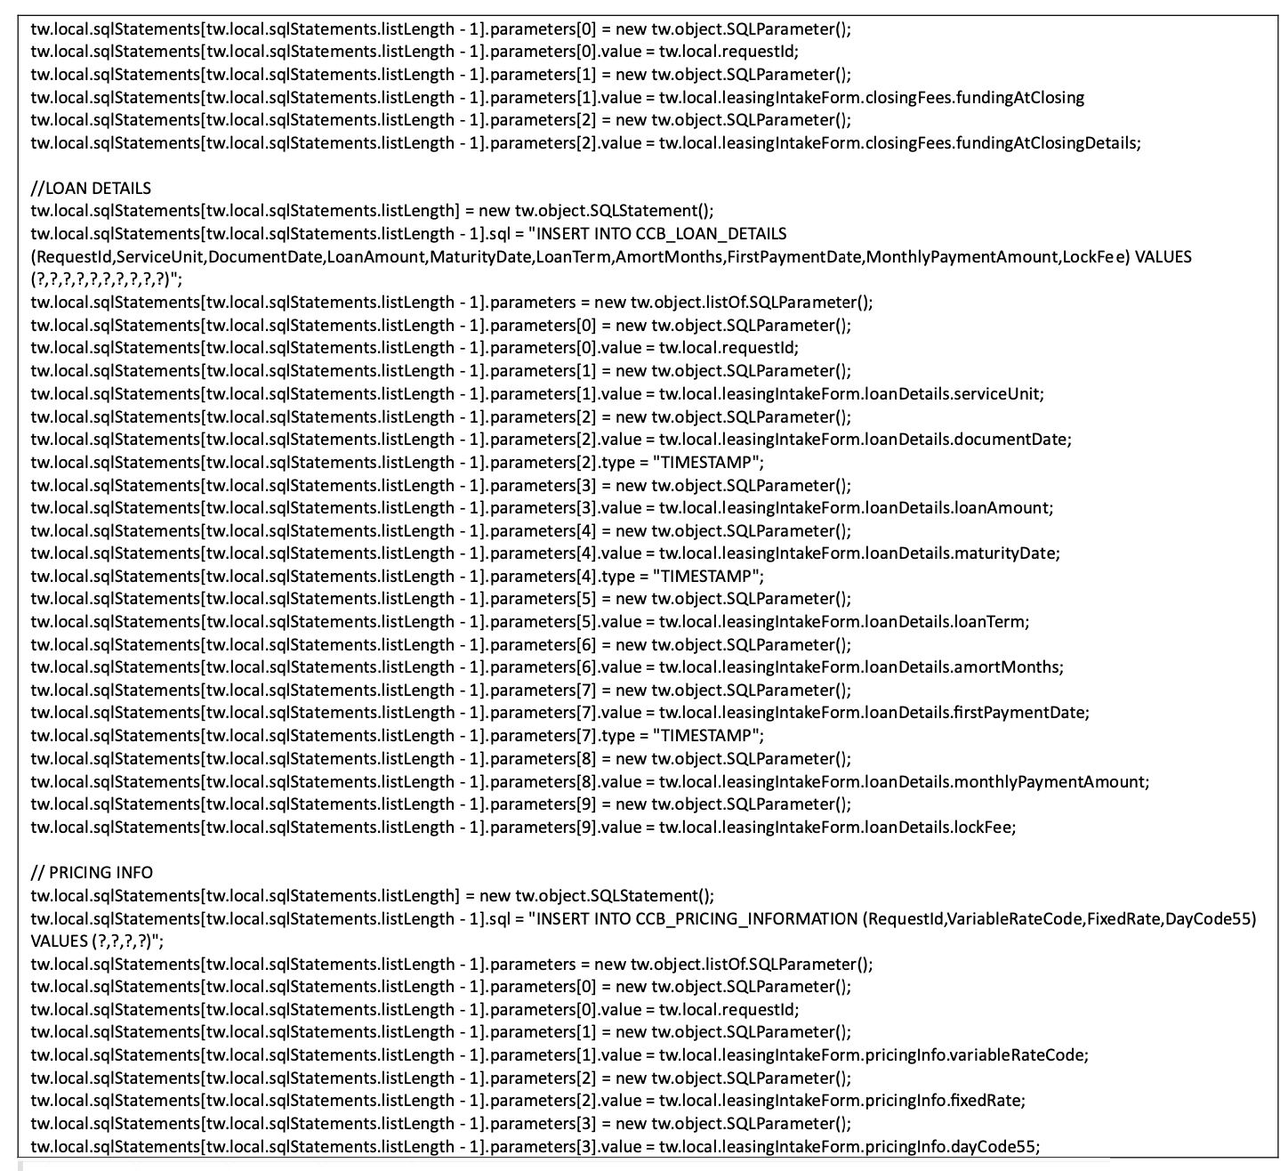
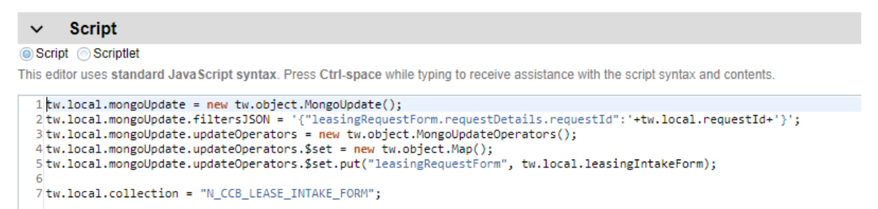
Always consistent flexible object Store (No SQL DB)
Development Cost Savings
Tons of code reduced to few lines instead to just bind object
Quick Access To Market
Flexible db model to incorporate object structure changes on the fly
Code samples from POC to Delete the existing record based on the RequestId and insert the new data. The data in SQL is maintained in different tables, so there are multiple deletions and inserts.

Slide 8
Always consistent flexible object Store (No SQL DB)
Development Cost Savings
Tons of code reduced to few lines instead to just bind object
Quick Access To Market
Flexible db model to incorporate object structure changes on the fly
DB Operations | Time needed per Developer (SQL Server) | Time needed per Developer (Mongo)
Data Save calls (Insert, Update) | 8 hours | 20 mins
Multiple insert/update/delete calls: | 16 hours | 20 mins
Data Get calls (Select queries): | 6 hours | 20 mins
Complex queries/Stores Procedures: | 24 hours | 4 hours

Slide 9
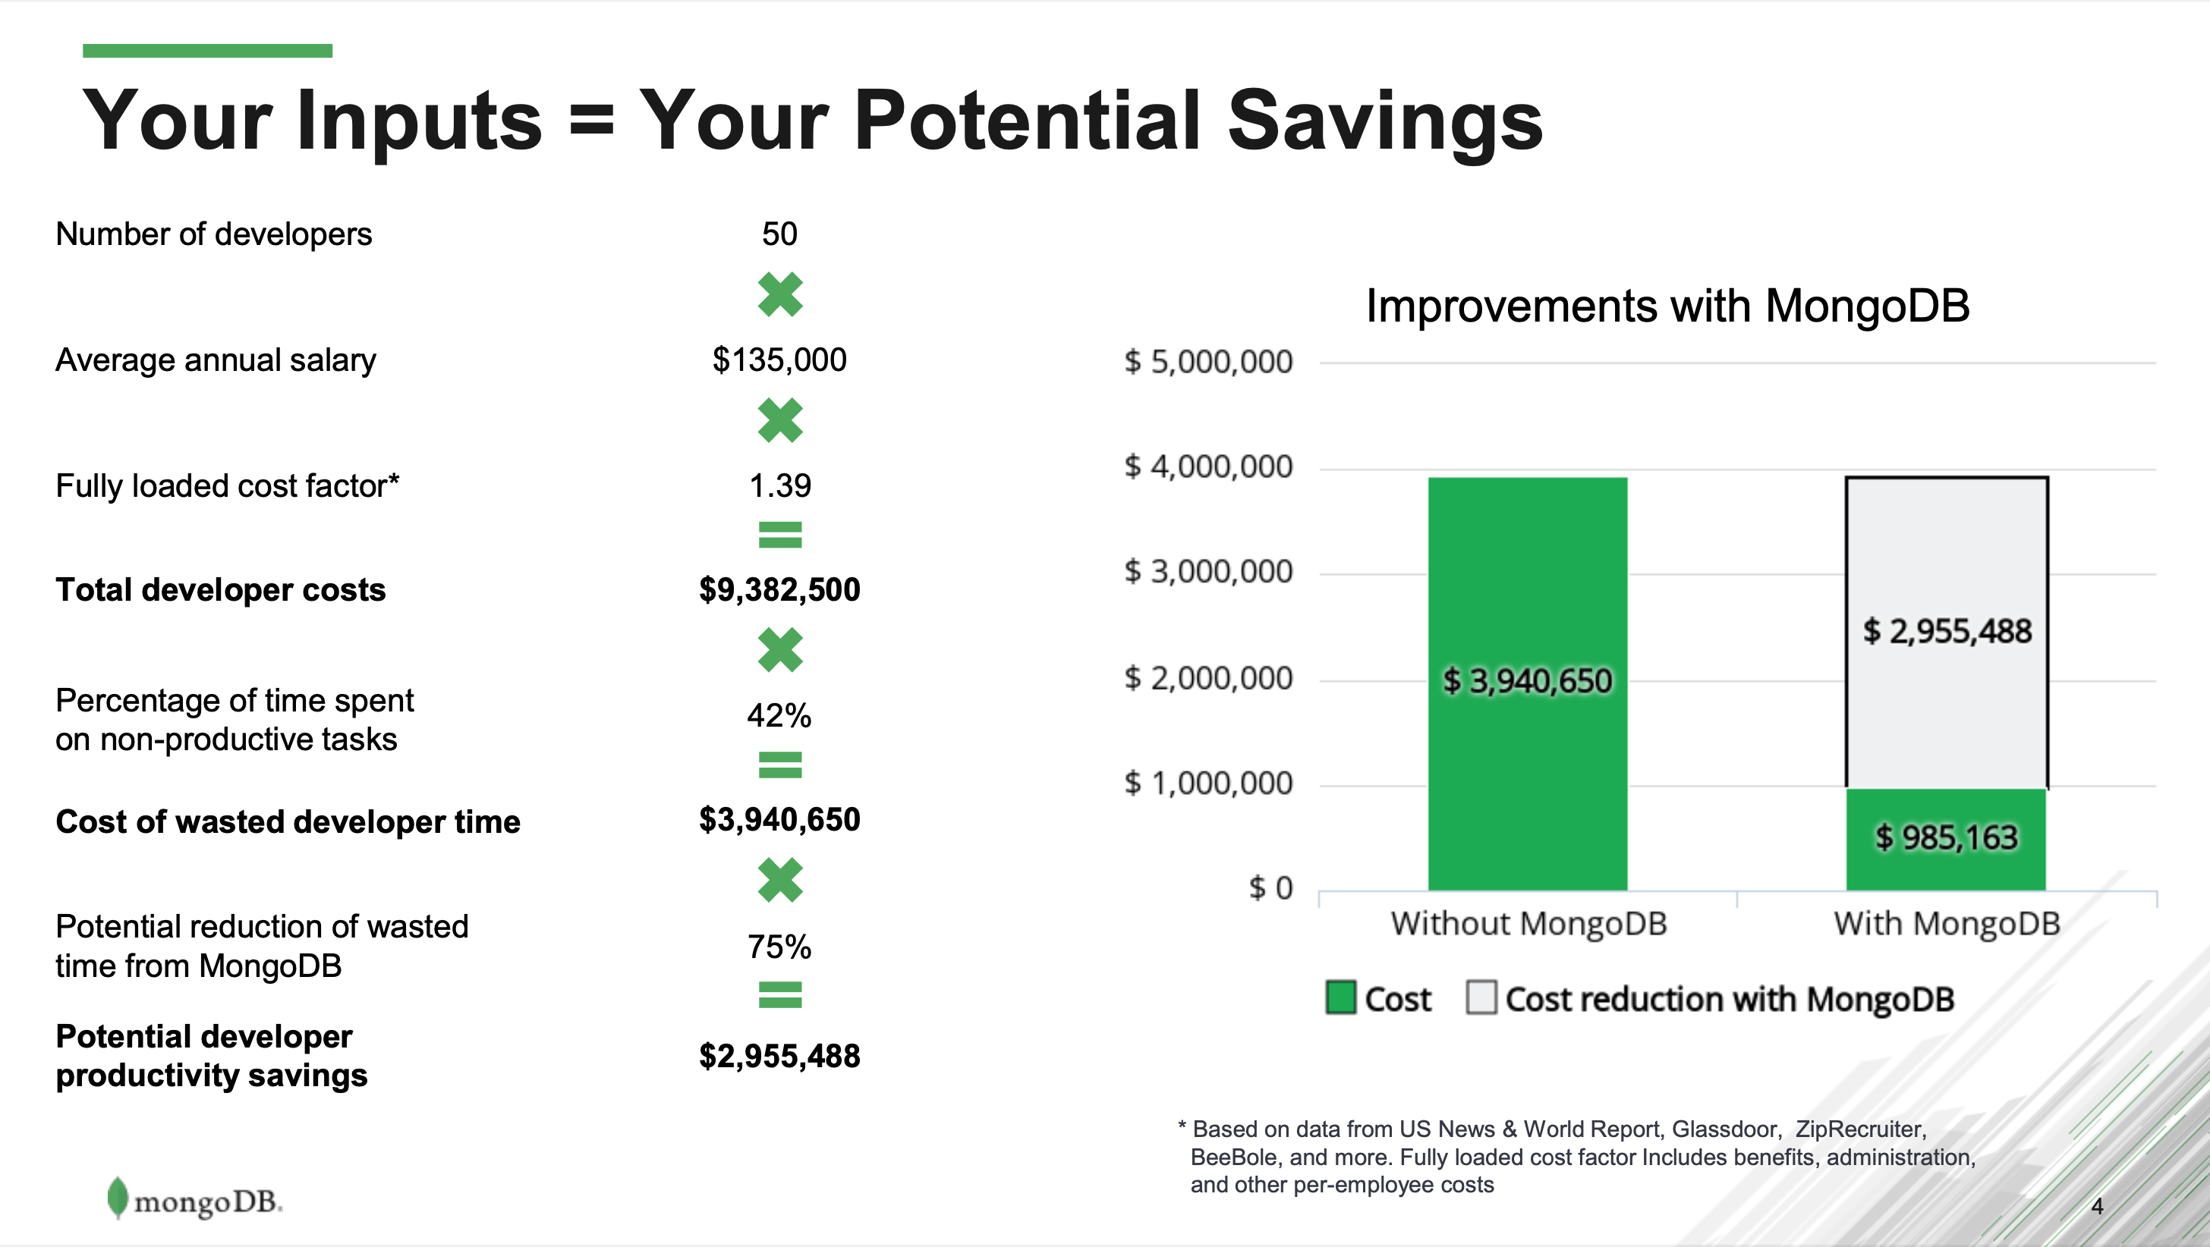
Always consistent flexible object Store (No SQL DB)

Slide 10
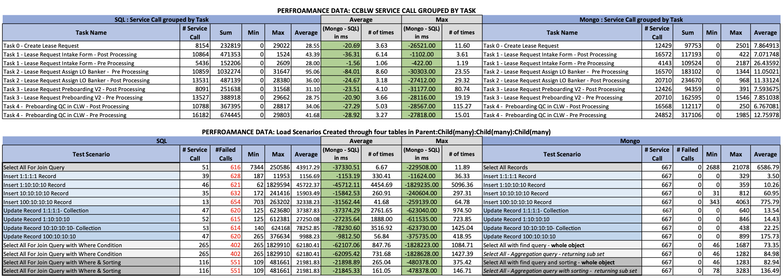
Always consistent flexible object Store (No SQL DB)
Improve Operational Efficiencies:
Much faster response times to save/retrieve objects
No Timeout, lockout issues:
Stability and Resiliency
No performance issues, db errors noticed in Load Test (SQL Server vs Mongo)

Slide 11
Always Consistent flexible object Store (No SQL DB)
High Availability With Always Consistency
Secondary Apps can access data from secondary nodes where little old data is ok to get data fast without putting load on primary server
Primary app can always read/write data to primary node to achieve always consistency.
 |  | Cassandra | MongoDB | CosmosDB
Flexibility |  | Low | High | Medium
 | Schema less | No | Yes | Yes
 | Transaction Support for multiple operations | N/A | Yes | No
 | Compound Indexing Capability | N/A | 32 levels | 6 levels
 | Joins | N/A | Supports Multiple | Supports One Join
 | Object Size | N/A | 16mb | 2mb by default. Configurable to 16mb
Consistency |  | Strong Consistency achievable but slows down response times | Always consistent | Strong Consistency achievable but slows down response times & operations charged higher
 | Is always consistency achievable for Primary app by Default? | No | Yes (Primary app can always interact with Primary Server) | No
Pricing |  | Higher For Strong Consistency | Stays the same for Always Consistency | Higher For Strong Consistency
 | For Strong Consistency | N/A | Stays the same as regular | 2 X regular pricing
Interoperability | Regulation to be able to shift cluster between cloud providers or to onPrem | Yes | Yes | No

Slide 12
Enterprise Data Strategy – Integration with ELZ
Current
Future
BPM App
User
Tibco
Tibco
Others
BPM App
User
BPM no longer controls the data structure
Database
BPM App
Graph (logic)
Stored procedures
Mongo
Where do the stored procedures go?
Cassandra (logic)
Online 360
Should offline 360 access happen outside of the graphs?
Timelines are not established for Cassandra response on creating objects
Offline 360 (end of previous day)
Read
Update
Graph Read
Graph Update

Slide 13
 | RDBMS (SQL Server) | Mongo | Atlas (Mongo IAS)
Infrastructure | Memory: 382.6 GB CPU: 48vCPU, 24 physical Storage: 3727.336 GB | Memory: 32 GB CPU: 8vCPU Storage: 2048 GB (With compression you get 65% data reduction) (50-75% reduced) | m50(32GB RAM, 8vCPU), 4096GB Disk (More disk, more IOPs in cloud) (50-75% reduced)
Licensing | For SVCKSA69901A0FK (Prod Server), 24 cores - 84K and then yearly maintenance. The other server, 8 cores - 28K with yearly maintenance. | Estimated licensing costs: [$99,500 - 1 RAM pool, up to 256 GB $64,490 – ½ RAM pool, up to 128 GB] $64,490 1/2 RAM pool (42.4% Cost Reduction) | Estimated licensing costs: $56,635 (M50 Tier) (49.4% Cost Reduction)
Development Cost Savings |  | 75% DB related development cost can be saved. Considering 25% of development work as DB work, we can achieve: 18.75% development cost savings | 75% DB related development cost can be saved. Considering 25% of development work as DB work, we can achieve: 18.75% development cost savings
Data Migration tool between RDBMS & Mongo | Relational Migrator: https://www.mongodb.com/products/tools/relational-migrator Mongo partner Capgemini is willing to help here, and they have a comprehensive tool for this.
Guide on AS-IS Conversion | https://gitlab.us.bank-dns.com/axsult1/db-techmod/-/blob/main/MongoBAW_Integarion.md
Guide on Optimized Conversion | https://gitlab.us.bank-dns.com/axsult1/db-techmod/-/blob/main/Implementation/Phase%202/Readme.md

Slide 14
Patterns/APIs & Code Samples
Java Jar file can be imported to perform Mongo CRUD operations from BPM
BPM toolkit is available to perform Mongo CRUD operations.
APIs to convert current SQL Server Implementation to Mongo in AS-IS Strategy
https://gitlab.us.bank-dns.com/axsult1/db-techmod/-/blob/main/MongoBAW_Integarion.md
APIs to implement DB operations in No SQL Way (Save/Retrieve Objects)
https://gitlab.us.bank-dns.com/axsult1/db-techmod/-/blob/main/Implementation/Phase%202/Readme.md
Patterns for db modeling/ indexing and perform CRUD operations
https://gitlab.us.bank-dns.com/axsult1/db-techmod/-/blob/main/Implementation/Phase%202/documents/HowTos/MongoDBPatterns.md
How to handle Aggregate Scenarios:
Dashboards accessing data from SQL Server/Mongo And Getting data from multiple databases
https://gitlab.us.bank-dns.com/axsult1/db-techmod/-/blob/main/Implementation/Phase%202/documents/AggregateFunctionalityDocumentation.md
How external reporting tools (Tableau/DAS-H) can access data from Mongo:
https://gitlab.us.bank-dns.com/axsult1/db-techmod/-/blob/main/Implementation/Phase%202/documents/ExternalReportingDoc.md
Migrating stored Procedures to Mongo
https://gitlab.us.bank-dns.com/axsult1/db-techmod/-/blob/main/Implementation/Phase%202/documents/StoredProcedureMigration.md
Working with enterprise groups to get approval for applications to use Mongo
Ashoo – WM Architecture Lead
WM Data Architecture (Shiva sood under Udai)
Enterprise Architecture Group (Prasad Vallabhaneni)
Data Architecture Group (Reena Cheema under Vijay Akella)
USB Mongo team (Subhodip Biswas with John K Rubbo)

Slide 15

Thank you

Slide 16
Appendix

Slide 17
Consistent flexible object Store (No SQL DB) - Mongo
Improve Operational Efficiencies:
Much faster response times to save/retrieve objects
No Timeout, lockout issues:
Stability and Resiliency
No performance issues, db errors noticed in Load Test (SQL Server vs Mongo)
Development Cost Savings
Tons of code reduced to single line mapping of object code
Quick Access To Market
Flexible db model to incorporate object structure changes on the fly
High Availability With Always Consistency
Secondary Apps can access data from secondary nodes where little old data is ok to get data fast without putting load on primary server
Primary app can always read/write data to primary node to achieve always consistency.

Slide 18
Current DB Design
We have about 17 applications deployed in our BAW platform
Our current database type is SQL Server for both BAW Product database and applications specific databases.
Each non-prod environment has one DB server.
Production has one primary, and one secondary physical server and production environment is replicated in DR environment.
All applications and product databases reside on same one DB server per environment.
Completed instance data is archived into archival database located on same server, after certain period.
Other applications, reports and data platforms (DataMart/ODS, DataHub) retrieve data from same server where online data resides.

Slide 19
Current DB Design - Problems
BAW apps are transactional workflows dealing with in-flight data objects but are not reporting systems or system of records for external apps.
However, new data captured in BPM apps can be transferred to a reporting platform/data warehouse versus being accessed from BPM database as currently happening.
BAW apps need persistence layer best suited for objects where they can store objects and retrieve objects as-is, not available with SQL Server relational modeling.
Extra Design/Development cost:
Extra design Effort: Apps need database that follows their objects model, relational databases can’t do that. We need to do following unnecessarily may be:
The objects need to split into multiple tables, thus extra effort required to design tables for objects.
Need to perform normalized data modeling
Design Entity relationship diagrams that may not follow object models,
Also need to define tables for relationships like many to many relationship, Parent/Child relationships.
Extra development effort:
Developers need to understand DB model
They need to write code to read/write objects after determining how the object should be read from tables or should be written to tables and which tables.
Impact on performance:
Performance Issues: By saving objects into multiple tables or retrieving from multiple tables through joins can cause performance issues.
Slow response, timeout, lockout issues: All applications including external applications accessing data from same database server can cause slow database responses, table lock out issues, timeout issues.
Note: BAW product DB will stay on SQL server as it is based on vendor’s recommendation, but application database can move to a better suited DB type.

Slide 20
One DB Design
In the absence of appropriate Db platform availability within USB, One DB Design was devised.
One DB Design allows dumping of objects and then retrieving the objects as is in relational tables. Basically, it is a persistence layer for memory dump.
In One DB Design, objects are mainly stored as JSONs in a common objects table
Objects can be indexed and queried through search fields table containing fields linked with objects in objects table.
All BAW apps can follow same One DB Design to save on DB design and development cost
One DB Design also reduces application development cost.

Slide 21
One DB Design

Slide 22
Appropriate DB? NO SQL DB (Mongo DB) & its Value Additions
NoSQL DBs are better suited for in-flight data of transactional apps and for object-oriented modeling because
NO SQL DBs saves data as object files
Data can be retrieved through object queries
NO SQL DBs follow application object models
Value Additions:
Save on DB design/development cost:
With Mongo we can save/retrieve business objects as is including hierarchical objects.
Developer does not have to create or design Relational DB Model/ ER Diagrams/ normalized tables structure
Save on App development cost:
Developer does not have to think about transforming Business object into tables while developing application.
Enhanced performance:
No SQL DB gives better performance for transactional systems or object-oriented applications, since data will be saved and indexed as binary object files matching in-memory objects.
There is no conversion of object into tabular form.
Parent object with child objects can be saved in 1 call. For example, if an Object has child object as array of 20 items. In Mongo – 1 call to save Parent Object with its child Array Object into the collection; In SQL server - 20+ write calls will be needed.
Data can be retrieved through replicas to provide high performance for select queries where little old data is not an issue without effecting primary application
ACID: Yes – Primary application can read/write from Primary Node, which is always 1 node and write can only happen to primary node in Mongo.
Highly Scalable: Horizontal Scaling available for Read in Mongo and not in SQL Server which is only vertically scalable
Highly Available: Data can be read through replicas that provides high availability for data read.
Reporting: Can utilize Mongo DB BI connector in absence of ELZ
Mongo has a connector called Mongo DB BI to build reports where data can be queried via SQL queries.
SQL queries can run on replica this way to retrieve data when ELZ is non-available
Notes:
How about pagination in Mongo, as we don't want to retrieve so many records from given collection or query?

Slide 23
Why MongoDB vs Other NO SQL DBs (Azure Cosmos, Cassandara)
We have an internal USB Mongo team supporting Mongo platform within the bank. They have shared information with us that only Mongo DB and Cassandara DB are approved by the Bank.
Also, Cosmos DB can only store objects of size up to 2mb whereas Mongo can save objects of size up to 20mb
If Cassandra is not right fit for us than the only choice is Mongo.
Cassandra is not the right fit for us because of following two things:
Mongo is more flexible with Data In Transit Object Models:
You have to define schema tables in Cassandra whereas in Mongo you don’t need to define schema for objects.
Cassandra saves objects in tabular form whereas Mongo saves objects in object files.
Mongo is very flexible with In-Memory objects as no need to define schema beforehand and if object changes in the application, it still takes in those objects with modified structure on the fly.
Mongo is ACID, Cassandra is not:
Cassandra is great fit for high availability where consistency lag (eventual consistency) is OK.
Read/Write can happen to any node in Cassandara. This will allow faster writes to the database. However, if application needs to be ACID, then Cassandra is not the right fit.
You can make Cassandra as ACID but that will make DB writes really slow in Cassandra as all nodes need to be updated, before corresponding read can be served.
This will also make Cassandra less Available.
However, Mongo DB follows Single Primary server and multiple secondary servers’ architecture where write can only happen to Primary server.
So primary application will only interact with Mongo Primary server and other apps can get data from secondary servers.

Slide 24
 | SQL Server RDBS | CASSANDRA | MONGO
ACID | Yes | Can Be (Not Ideal) | Yes
High Availability, little old data is OK | Not Allowed. | Winner!!! | Yes
100% consistency | Yes | Can Be (Not Ideal) | Yes/ Better Designed for this.
Object oriented Modeling & Flexibility | Least Favorable | 2nd Choice | Winner!!!
Env. Avail. to Dev team - DB Changes/Deployments | DEV Only | POC env partially available | All environments under App Team Control
Need to Create APIs | No | Yes (GraphQL APIs.) | No
Can copy to ELZ | Yes | Yes | Yes
Licensing Model | Established Licensing Model | Shared Enterprise Platform | Shared Enterprise Platform.
Configurations are tricky, since infrastructure is based on multiple nodes and read/write can happen from any node. Also, transaction rollback/commit model is followed through batch processing, which is bit different than how RDBMS handles it.
ACID by default but we can play with configuration for example to make it more available and less consistent. Mongo follows RDBMS like model to have one primary server and you can read/write from primary server. You can choose to have replicas updated at the same time or allow few milliseconds gap for the write and then read based on majority. (Does the read majority work within Data Center?)
Ideal for Catalog apps, like Netflix, Amazon shopping, Enterprise Data. Supports multiple replication across multiple regions. Read/Write from any node, from closest to consumer
Can be configured to be more available and less consistent. Follow Primary server concept for Write and has replication/ Sharding model. Read can be from Primary OR from replicas based on majority OR from any replica with majority or not.
Difficult to scale for Higher Availability. Always 100% consistent.
Configurations are tricky
Mongo can be configured to be more Available and can replicate in Other Regions like Europe. But since Mongo follows primary server model, It can be 100% consistent with primary application reading/writing from Primary Server. More suitable for Application databases that are not SORs, for our use cases.
You need to design tables and save json objects in columns while have separate columns for significant/searchable fields. To reduce number of tables, Generic tables with Generic columns (col1, Col2) to be defined to contain multiple objects. OneDB follow that design since that is the only option in RDBMS
Can get/save json objects from tables, also can have custom object types for Columns following json child-object structures but can go up to 1 level and not beyond that and same goes with indexing (To confirm what level?). But tables need to be created before hand, otherwise save all fields as JSON in text column that can be indexed text based and that is complicated.
Get/ save json objects. Table structures/ indices / collections can be updated dynamically. Just design your business objects, don’t worry about designing database/ ER diagrams. Objects can be multi-hierarchy and indexing supports multi-hierarchy
For Higher environment run DB scripts as part of deployments and for UAT and PROD need approvals to run db script
Use POC as Dev. But can partially work because still need to confirm db design with Cassandra office hours and need to get APIs created even in POC with the support of another team. For higher environments need to follow process and get approvals from Cassandra team
Db changes will be minimal since tables/indices can be created/updated dynamically. Need to produce our own process depending on we are going to use Mongo Containers, or Mongo SaaS called ATLAS or On-Premise (Need to get our own servers)
Need to confirm with Data Platform teams
Not very clear to us but TOS manages it with BL and follow some Shared licensing Model. Also, for Hardware, in some cases BL pays for it and sometimes Shared servers cost model is utilized
More restrictions though. On Prem Pre-built hardware setup and applications onboard to it. Apps can select data-centers and number of servers in data-centers. Migration to public cloud (GCP) in-progress.
Mongo containers on existing USB hybrid cloud infra, may need to only pay for mongo license. On Public cloud need to pay for infrastructure also OR Manage Mongo SaaS ATLAS service cost (don't know exact cost but generally SaaS is expensive than other options) OR Mongo- On-premise - Provision your own servers and bear their cost and On-Premise hardware Provisioning takes time plus Mongo Licensing cost.
USB Mongo team asks apps to bear licensing cost of 1st year and afterwards they will take care of it.
DB Of Choice: MONGO DB
Infrastructure will be 3 nodes in one Data Center (Primary) and 2 in Other Data Center (DR). Read/Write will happen from Primary node in Primary Data Center.
Primary node in primary datacenter will update secondary nodes (replicas) asynchronously across data centers and that will take few milliseconds.
Other application reads data from replicas only. We can control read to read majority (3 nodes), if more consistency is required.
In BAW Apps (100% consistency is required): We read BPM database to see how many shares an account assert has. Initially this assert might have 100 shares and the user has created a request to transfer 50 shares already and tries to update the database. Meanwhile another request has been created in BPM to transfer about 80 shares from the same account assert. If the data is consistent, then the user who created the second request will get error message stating it doesn't have enough shares to transfer. Otherwise, will be receiving older data which will still assume it has 100 shares available.
External Apps (Little lag is ok): A report in a reporting app shows how many Account asserts with shares are present in an account. Now if latest data has 10 account asserts, however the replica being accessed by reporting app, has little old data with 8 account asserts, then it is ok if little old data of 8 account asserts is shown in the report. Few seconds later report can be refreshed to show 10 account asserts
Contacts:
Cassandra Office Hours:
Hagen, Jennifer <jennifer.gaboury@usbank.com>;
Liesenfelt, Thomas J <thomas.liesenfelt@usbank.com>
Cassandra Manager/Architect: bijulal.gopinathannair@usbank.com
GraphQL APIs: Hagen, Jennifer <jennifer.gaboury@usbank.com>;
Samal, Radhanatha <radhanatha.samal@usbank.com>
USB Mongo Team: ryan.hoeksema@usbank.com
Mongo Vendor: Sean Latterner <sean.latterner@mongodb.com>;
Cassiano Ziegler Bein <cassiano.bein@mongodb.com>
SQL Server DBA: SQL.Server.DBA.Group@usbank.com;
SQL Server DBA Manager: Clousing, Michael D <michael.clousing@usbank.com>

Slide 25
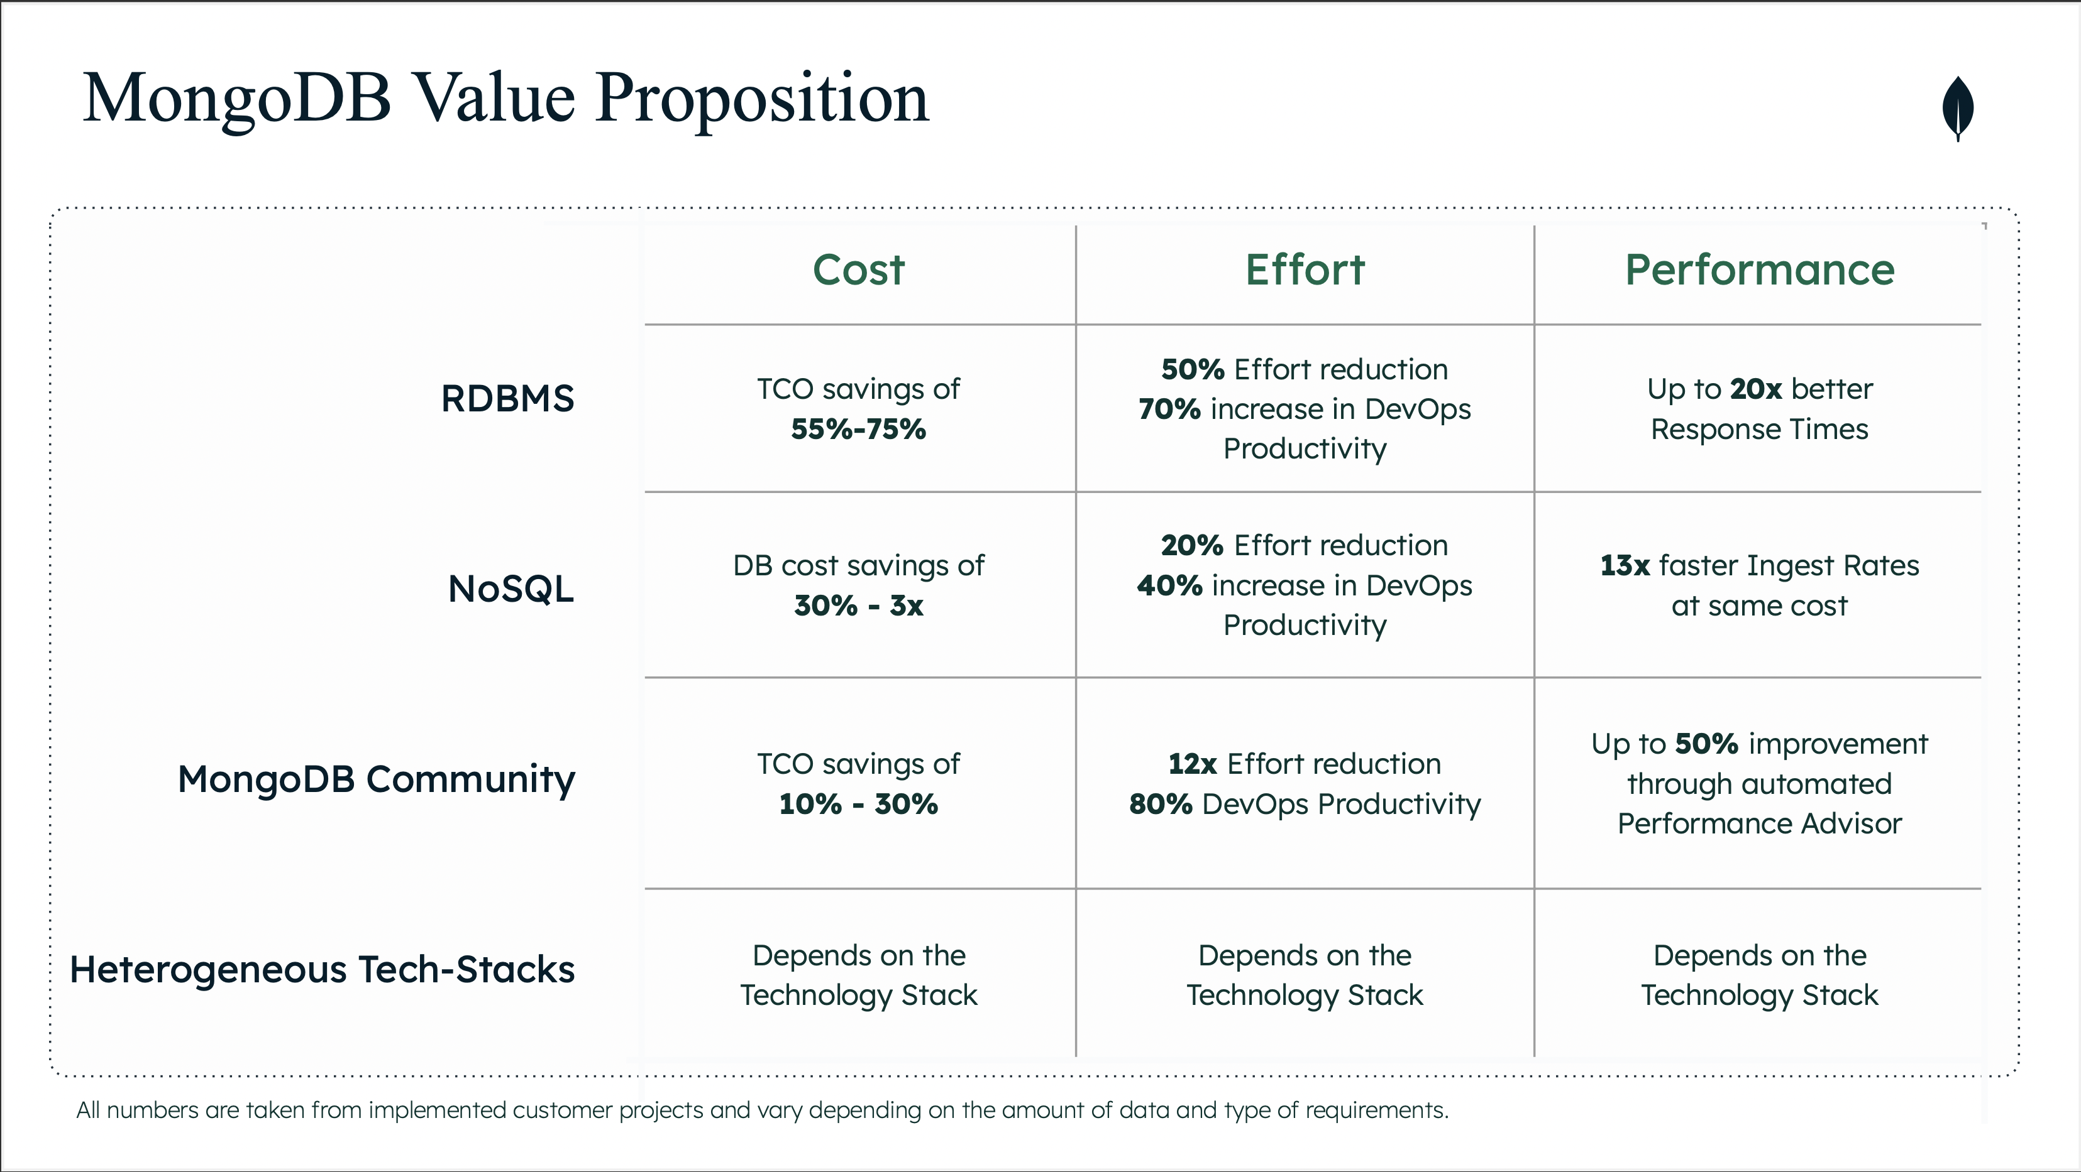
Why MongoDB

Slide 26

Data Strategy POC Roadmap
12-Jun
25-Jul
13-Mar
2-Jun
5-Jun
21-Jul
Performance Test
24-Jul
11-Aug
14-Aug
8-Sep
?
?
As is Conversion
Conversion- Mongo Way
Aggregate Functionality Conversion
Data Archival
Data Export to ELZ
1. Connection pool
2. Java code changes
3. BPM code changes
1. Connection pool 2. MongoDB Data
Modeling
3. Java Code
4. BPM Code Changes
Internal Reporting/ Dashboards
External Reporting
Integration with data Platform
Stored Procedures
Querying multiple databases/ DB Links
Data Archival Recover Instances
from Archive data
Prep. Performance Test.
Conduct Performance Test on Matching SQL server (may be IT) and Mongo environnements
Share Analysis
Build Report showing
Performance Improments
Development cost savings
Share results with App teams and conduct demos

Slide 27
Next Steps: Get Enterprise Architecture Approval
Approval to use Mongo as DB for BAW applications:
MongoDB Prod already exists supported by internal team, being used by apps, so no additional work needed from MongoDB product approval perspective.
If we cannot go through UDAIP (Consolidated Platform) which includes Cassandra (If not no SQL DB Cassandra, then relational DBs SQL server or Postgres), Kafka, ELZ, CDI Pipeline, Offline 360 then state why MongoDB is the right database to use for our BAW application.
ELZ – Data at rest for Reporting. We need to connect MongoDB to ELZ to inject data for reporting. EOD or after certain period, activity will go to ELZ using Kafka topics and that can be done without Cassandra.
Awais and Rosha to Provide - Description of Use Case why we need to use MongoDB as primary database for Data in transit to Shiva.
As per Subhodip – We have to contact Gillingham, Matthew P and Jagannath, Venkata K from Enterprise Data Architecture, for MongoDB Approval. Shiva will help us here.
Subhodip has provided our L4 Enterprise Architect (Thejaswi Urs and Prasad Vallabhaneni) to get additional support for Approval process with Mathew's group
Kalyan Tappa is CDA from Matt’s team
ATLAS (Mongo DB platform as a service) is not an approved platform.

Slide 28
Next Steps: Evaluating USB MongoDB Infrastructure Setup
For MongoDB – For PROD env. we will have two Data Centers, three nodes in one data center and two nodes in another data center.
Recommendation is to setup minimum 5 nodes (3 in OBC and 2 in CBC).
Any 3 of the 5 should be satisfied if we set Majority read.
USB Mongo team will move one of their nodes out of 5 (Voting Node) to Azure down the road.
One node will always be Primary and remaining are Secondary nodes. Primary applicant can Read/Write on Primary node to avoid consistency issue or read lag.
Production environment has one DR data center.
Primary performs Asynchronous update to all the secondary nodes within few milliseconds gap.
Other application/reports can read data from replica, we can control read to read majority to gain more consistency.
BL/Application team needs to pay for VMs/infrastructure if they want all nodes in Azure
MongoDB Sandbox Environment Specs (RAM can be scaled up if requested):
Server Count: 1
vCPU: 4
RAM: 16GB RAM
Storage: 295GB
Notes:
Find Production Apps footprint for Mongo (Number of Apps, Apps scale, data size)?

Slide 29
Next Steps: Evaluating MongoDB Cost Model (OnPerm & OnCloud).
For both OnPerm and Azure – Cost Model will be same.
For Azure – BL has to pay for VMs/ Infrastructure.
MongoDB licensing cost may vary.
Application team need to pay first year worth of licensing and remaining years licensing will be taken care by USB Mongo team (Ryan’s team).
Some baseline licensing costs:
128GB RAM Pool: ~$65k per year
256GB RAM Pool: ~$100k per year

Slide 30
Road Map Table
Items | Sub-Items | Start date | End Date | Status | Desc | Setup-Determine | Remarks
Approval for mongo DB |  | ? | ? | In-Progress |  | NA | need to check with enterprise architect
As is Conversion |  | 13-Mar-2023 | 2-Jun-2023 | Completed |  | NA | What about logging? Java? It will have subitems - 1. Connection pool 2. Java code changes 3. BPM code changes
 | Connection pool | 13-Mar-2023 | 2-Jun-2023 | Completed |  | NA
 | Java code changes | 13-Mar-2023 | 2-Jun-2023 | Completed |  | NA
 | BPM code changes | 13-Mar-2023 | 2-Jun-2023 | Completed |  | NA
Conversion- Mongo Way |  | 5-Jun-2023 | 21-Jul-2023 | In-Progress |  | NA | Subitems - 1. Java Code 2. BPM Code Changes
 | Connection pool | 5-Jun-2023 | 12-Jun-2023 | In-Progress |  | NA
 | MongoDB Data Modelling | 5-Jun-2023 | 12-Jun-2023 | In-Progress |  | NA
 | Java Code | 5-Jun-2023 | 07-Jul-2023 | In-Progress |  | NA
 | BPM Code Changes | 12-Jun-2023 | 21-Jul-2023 | In-Progress |  | NA

Slide 31
Items |  | Start date | End Date | Status | Desc | Setup-Determine | Remarks
Performance Test |  | 12-Jun-2023 | 25-Jul-2023 | In-Progress |  | NA
 | Prep -Performance Test | 12-Jun-2023 | 23-Jun-2023 | In-Progress |  | NA
 | Conduct Performance Test | 24-Jul-2023 | 25-Jul-2023 | Not Started |  | ? | POC - ? , CCBLW team to check automation test team / Check with Rajesh
Aggregate Functionality Conversion |  | 24-Jul-2023 | 11-Aug-2023 | Not Started |  | NA | Need to have meeting with Data platform team - ( datahub - DataMart ) ,they need to get data from Mongo BII
 | Internal Reporting / Dashboards - Aggregate(Mongo db and Sql Server ) | 24-Jul-2023 | 04-Aug-2023 | Not Started |  | NA | Will create common bpm service , which will get data from Mongo db and sql server
 | External Reporting | 24-Jul-2023 | 04-Aug-2023 | Not Started |  | NA | Need to have meeting with external Reporting team - ( Tableau - Dash ect ) ,they need to get data from Mongo BI

Slide 32
Items |  | Start date | End Date | Status | Desc | Setup-Determine | Remarks
 | Integration with data Platform | 24-Jul-2023 | 04-Aug-2023 | Not Started |  | NA | Need to have meeting with Data platform team - ( datahub - datamart ) ,they need to get data from Mongo BI
 | Stored Procedures | 07-Aug-2023 | 11-Aug-2023 | Not Started |  |  | MongoDB provides the aggregation pipelines framework as mongo db does not support stored procedure
 | Querying multiple databases/ DB Links | ? | ? | TBD |  | NA | App team needs to copy data it needs from product to its own database to prevent any db links or joins with product db.
Data Archival & Recovery |  | 14-Aug-2023 | 8-Sep-2023 | TBD |  | NA
 | Data Archival | 14-Aug-2023 | 25-Aug-2023 | TBD |  | NA | Do we need archive data in mondo db like sql ? Can we only archive data in Mongo BI? Remove data from Mongo DB

Slide 33
Items |  | Start date | End Date | Status | Desc | Setup-Determine | Remarks
 | Recover Instances from Archive data | 28-Aug-2023 | 8-Sep-2023 | TBD |  | NA | are we using store procedure to recover instances ? Is there any separate utility exposed to team?
Data Export to ELZ |  | ? | ? | TBD |  | NA

